Slide 1
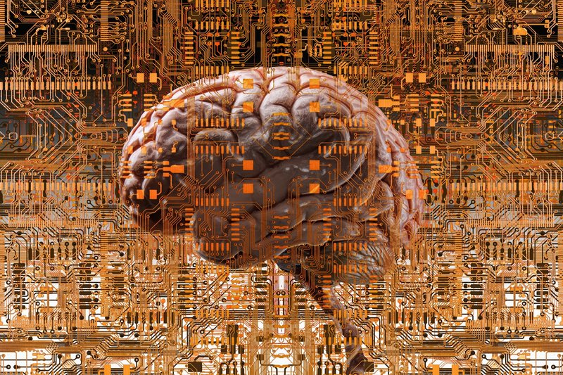
Science of Living System: BS20001
Brain structure and function
Abhijit Das
School of Bioscience
Email: abhijit.das@iitkgp.ac.in
Tel: 03222-260511

Slide 2
Our brain is the most sophisticated computational machine
It can change its own components and rewire itself into a new configuration as required for new function.

Slide 3
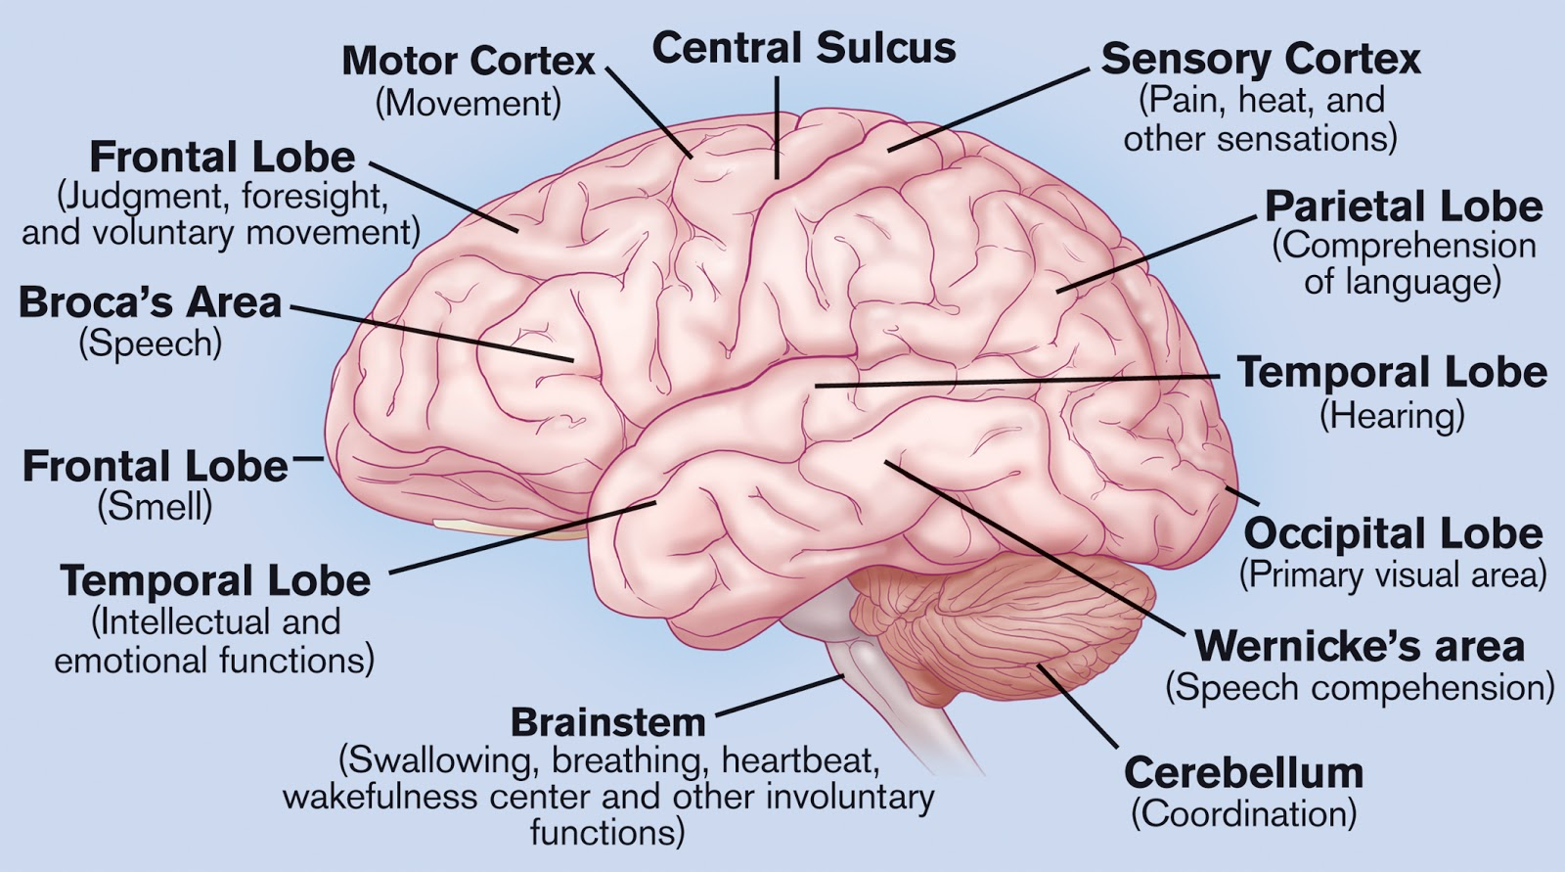
Anatomy and functional areas of the brain

Slide 4
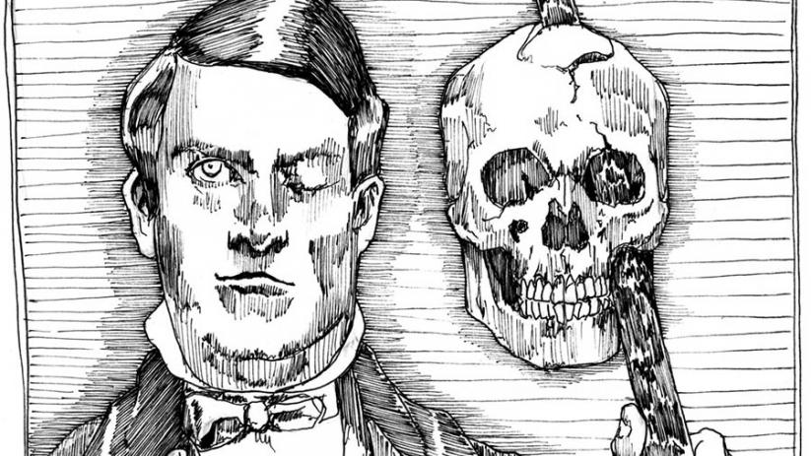
Accidental injury led to new discoveries in Neuroscience
A large iron rod was driven completely through his head, destroying much of his brain's left frontal lobe
His personality and behavior dramatically changed
over the remaining
12 years of his life‍
Phineas Gage (1823–1860) was the victim of a terrible accident in 1848.
His injuries helped scientists understand more about the brain and human behaviour, particularly role of frontal lobe in personality

Slide 5
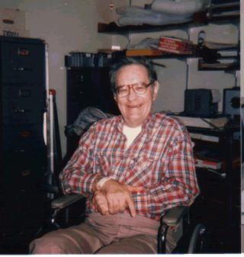
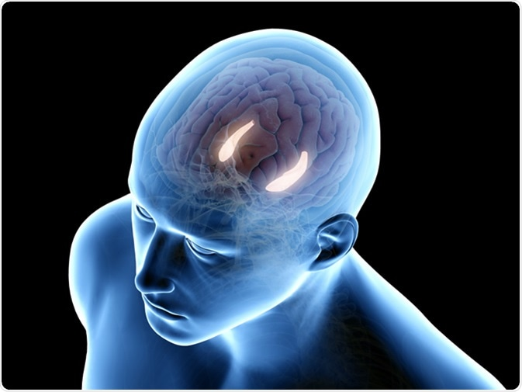
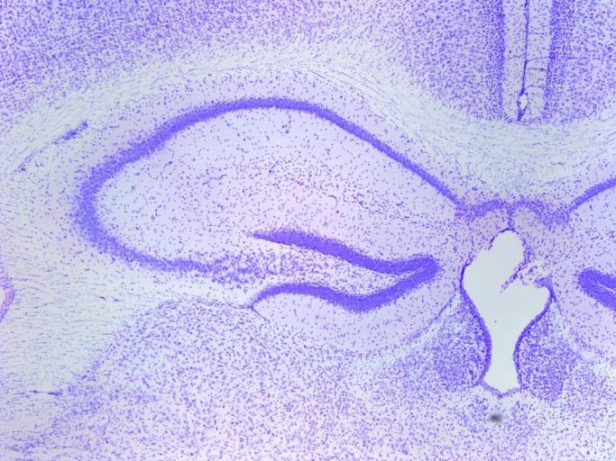
Man with no memory
HM lost the ability to form new memories after surgical removal of the hippocampus and nearby temporal lobe structures to treat intractable epilepsy.
Henry Molaison, widely known as "HM,"
3D image of hippocampus
Architecture of hippocampus
Hippocampus is essential for making memories, and that if we lose both of them, we will suffer a global loss of memory

Slide 6
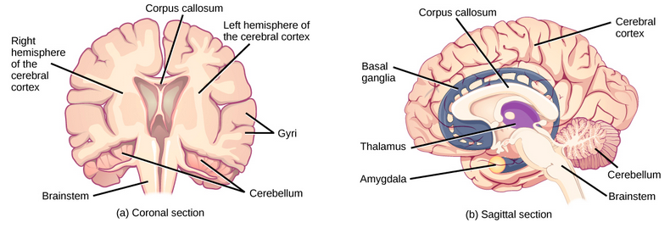
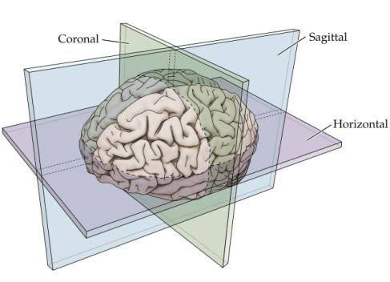
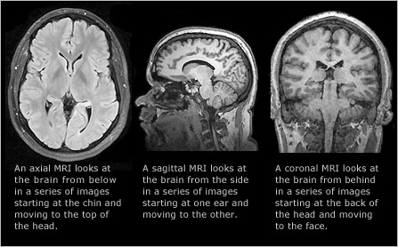
Internal structure of the brain
MRI scan of human brain

Slide 7
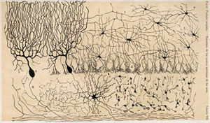
The neuron doctrine
Neurons are structural and functional units of nervous system
They are electrically excitable cells of the brain
Santiago Ramón y Cajal
Camillo Golgi
The 1906 Nobel Prize in Physiology or Medicine was awarded to both of them for revealing the inner beauty of the nervous system
Hand drawing of Ramon Cajal
Notes:
Camillo Glogi discovered Glogi stain. When brain are kept under silver chromate solution for few days, brain cells get darkly stained and show branching patterns with great details. Golgi proposed that two brain cells are connected with each other like blood vessels (there is no discontinuity).
Ramon Cajal using the same Golgi stain proposed that two brain cells are not directly connected with each other. There is a gap, which is now known as synapse.

Slide 8
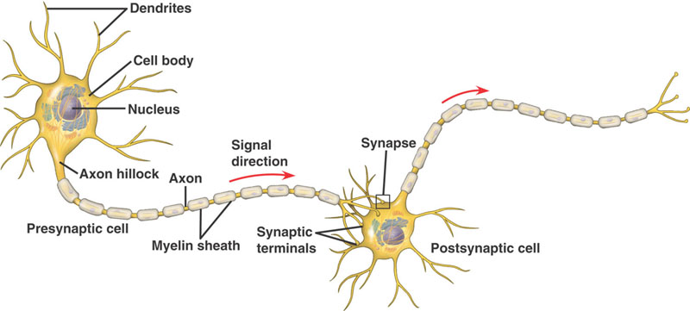
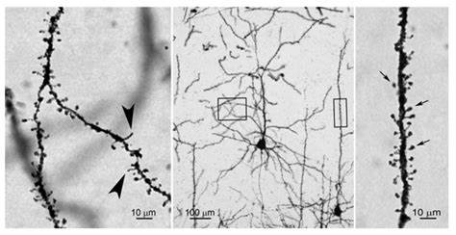
Structure of the neuron
Arrow points to the dendritic spines, connecting site with other neuron called synapse
Golgi staining

Slide 9
Golgi staining procedure
Immerse a block (approx. 10x5 mm) of formaldehyde fixed brain tissue into a 2% aqueous solution of potassium dichromate for 2 days.
Dry the block shortly with filter paper.
Immerse the block into a 2% aqueous solution of silver nitrate for another 2 days.
Cut sections approx. 20-100 µm thick.
Dehydrate quickly in ethanol, clear and mount.

Slide 10
Electrical activity of neurons:
Nerve Impulse or Action Potential

Slide 11
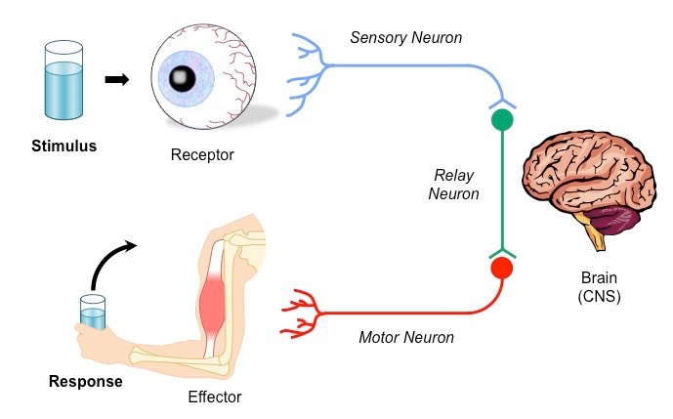
Our brain function depends on Stimulus-Response Pathway
Environmental Stimulus activates Receptors on Sensory neurons
Sensory neurons are excited (nerve impulse generated)
Impulse transmitted to Central Nervous System (site for decision making)
4. Response signal transmitted via Motor Neurons to Effector (Muscle)
5. Muscle contracts to take necessary action
Notes:
The basic pathway for a nerve impulse is described by the stimulus response model
A stimulus is a change in the environment (either external or internal) that is detected by a receptor
Receptors transform environmental stimuli into electrical nerve impulses
These impulses are then transmitted via neurons to the central nervous system where decision-making occurs
When a response is selected (consciously or unconsciously), the signal is transmitted via neurons to effectors
Effectors are organs (either muscles or glands) that produce a response to a stimulus
A response is a change in the organism resulting from the detection of a stimulus

Slide 12
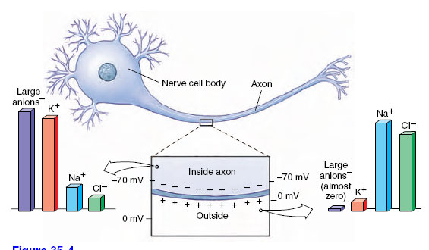
How is nerve impulse generated?
1. Resting membrane potential (RMP):
A electrical potential difference across the cell membrane
Neurons have resting membrane potential like all other cells (varies from -60 to -70mv)
Notes:
Resting Membrane Potential Membranes of neurons, like all cellular membranes, have a special permeability that creates ionic imbalances. The interstitial fluid surrounding neurons contains relatively high concentrations of sodium (Na⁺) and chloride (Cl⁻) ions, but a low concentration of potassium ions (K⁺) and large impermeable anions with negative charge. Inside the neuron, the ratio is reversed: the K⁺ and impermeable anion concentration is high, but the Na⁺ and Cl⁻ concentrations are low. These differences are pronounced; there is approximately 10 times more Na⁺ outside than in and 25 to 30 times more K⁺ inside than out.
When at rest, the membrane of a neuron is selectively permeable to K⁺, which can traverse the membrane through special potassium channels. The permeability to Na⁺ is nearly zero because the Na⁺ channels are closed in a resting membrane. Potassium ions tend to diffuse outward through the membrane, following the gradient of potassium concentration. Very quickly the positive charge outside reaches a level that prevents any more K⁺ from diffusing out of the axon (because like charges repel each other), and because the large anions cannot pass through the membrane, the positively charged potassium ions are drawn back into the cell. Now the resting membrane is at equilibrium, with an electrical gradient that exactly balances the concentration gradient. This resting membrane potential is usually −70 mV (millivolts), with the inside of the membrane negative with respect to the outside.

Slide 13
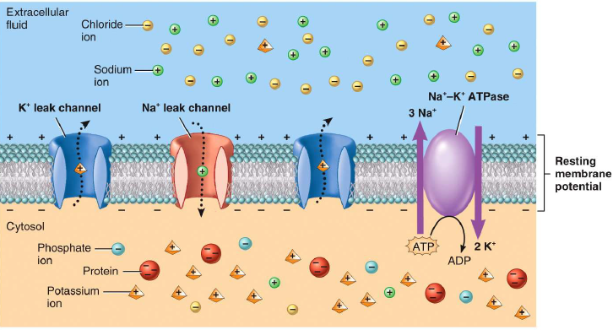
How is nerve impulse generated?
1. Resting membrane potential (RMP):
A electrical potential difference across the cell membrane
Neurons have resting membrane potential like all other cells (varies from -60 to -70mv)
Notes:
Ionic composition inside and outside a resting nerve cell. An active sodium-potassium exchange pump located in the cell membrane drives sodium to the outside, keeping its concentration low inside. Potassium concentration is high inside. Although the membrane is “leaky” to potassium, this ion is held inside by the repelling positive charge outside the membrane, and its attraction to large negatively charged anions inside the membrane, which cannot leave the cell.

Slide 14
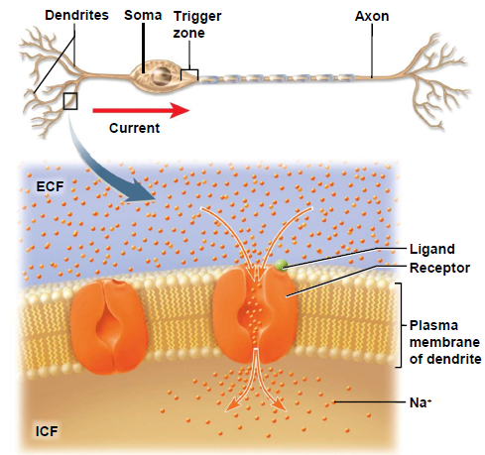
How is nerve impulse generated?
2. Local or generator potential:
When a neuron is stimulated by chemicals, light, sound, mechanical disturbance etc. local potential is generated
Stimulus activates specific receptor and allow Na+ to enter into the cell
Neuronal membrane depolarizes
Types of receptors:
Photoreceptor (eye)
Mechanoreceptor (ear)
Thermoreceptor (skin)
Chemoreceptor (nose, tongue)

Slide 15
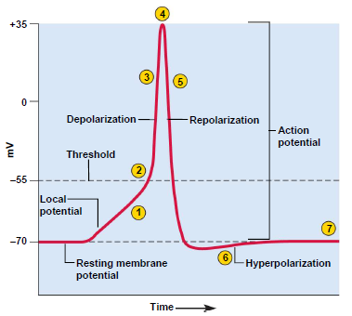
How is nerve impulse generated?
3. Action potential:
All or none law
If local potential reaches threshold, neuron fires at its maximum voltage
If threshold is not reached neuron does not fire
Notes:
A nerve impulse is a rapidly moving change in electrical membrane potential called an action potential. It is a very rapid and brief depolarization of the membrane of the nerve fiber. The membrane potential reverses for an instant so that the outside becomes negative compared with the inside. Then, as the action potential moves ahead, the membrane returns to its normal resting membrane potential, ready to conduct another impulse. The entire event occupies approximately a millisecond.
Threshold – critical voltage which local potentials must reach in order to open the voltage regulated gates at axon hillock.

Slide 16
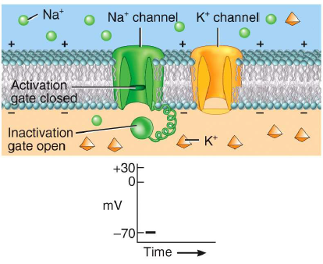
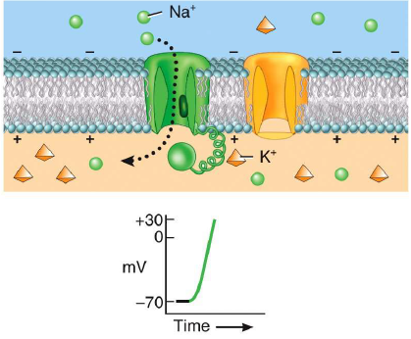
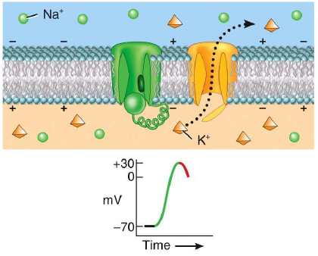
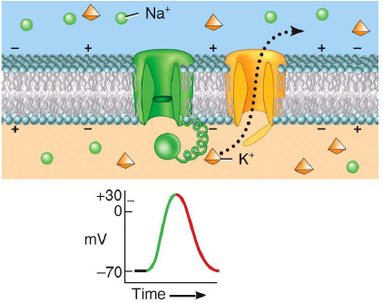
Resting state
Depolarization state
All voltage gated
Na+ and K+ are closed
Na+ channels open
Repolarization state begins
Repolarization state continues
Na+ channels closed
K+ channels open
K+ outflow continues

Slide 17
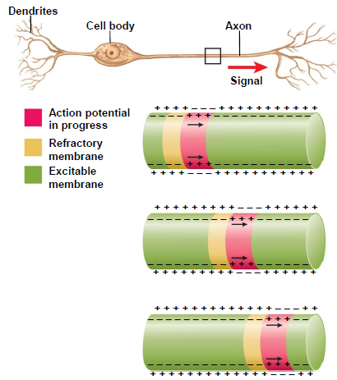
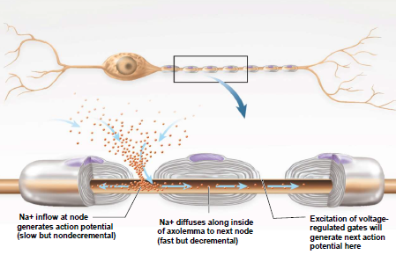
4. Transmission of nerve impulse:
Unmyelinated fiber
Myelinated fiber
Refractory membrane
Is in recovery stage
Saltatory conduction (faster speed)

Slide 18
Speed of nerve impulse
Myelinated neurons: 80-120 miles/sec
Non-myelinated neurons: 0.5-2 miles/sec
Nerve impulse speed could be 3 millions times slower than electricity

Slide 19
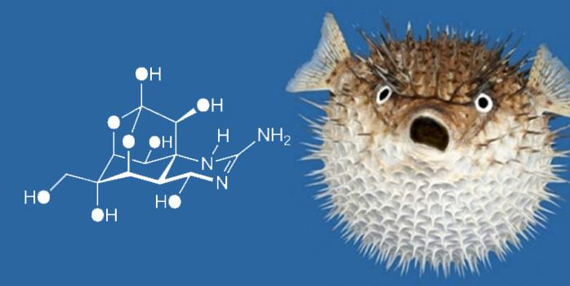
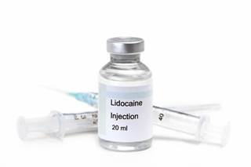
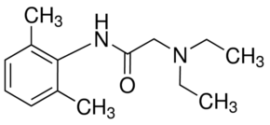
Sodium channel blockers
Tetrodotoxin: in puffer fish
More poisonous than cyanide.
Irreversible inhibitor
Lidocaine:
Used as local anaesthetic for dental surgery
Weak reversible blocker

Slide 20
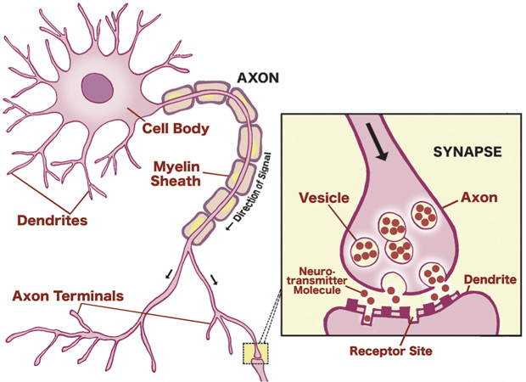
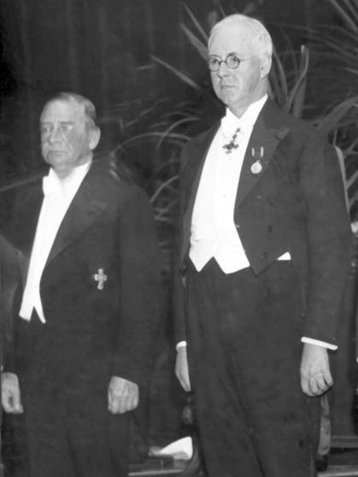
5. Synaptic transmission:
Discovery of the neurotransmitter
Otto Loewi
Sir Henry Dale
Neurotransmitters:
Acetylcholine
Dopamine
Serotonin
Glutamate
GABA etc.
The Nobel Prize in Physiology or Medicine 1936 for their discoveries relating to chemical transmission of nerve impulses
Notes:
Otto Loewi found that stimulation of vagus nerve (connected to the heart) slows heart beats in frog. He also observed that a chemical is released during stimulation of vagus nerve, he named it “vagusstoff”. Henry dale identified this chemicals as “Acetylcholine”.

Slide 21
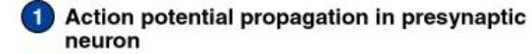
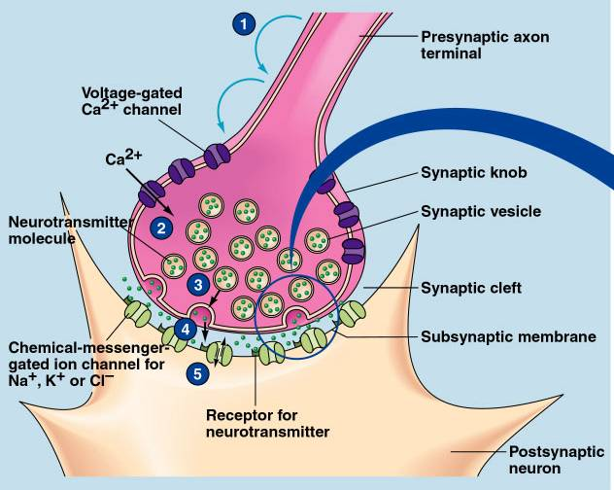
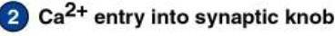
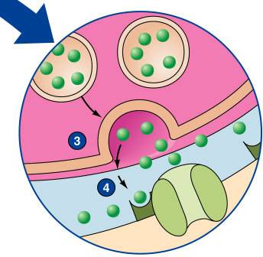
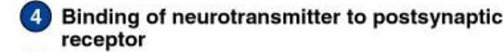
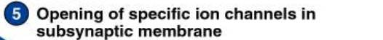
5. Synaptic transmission:
Ca²⁺

Slide 22
Sequence of events in chemical transmission across a synapse
5. Synaptic transmission:
Action potential reaches presynaptic axon ending
Presynaptic action potential opens voltage-dependent Ca2+ channels
Ca2+ causes vesicle migration, fusion with presynaptic membrane
Neurotransmitter released from vesicles by exocytosis
Neurotransmitter diffuses across cleft toward post synaptic membrane
Neurotransmitter binds to its receptor in the post synaptic membrane
Post synaptic membrane depolarizes

Slide 23
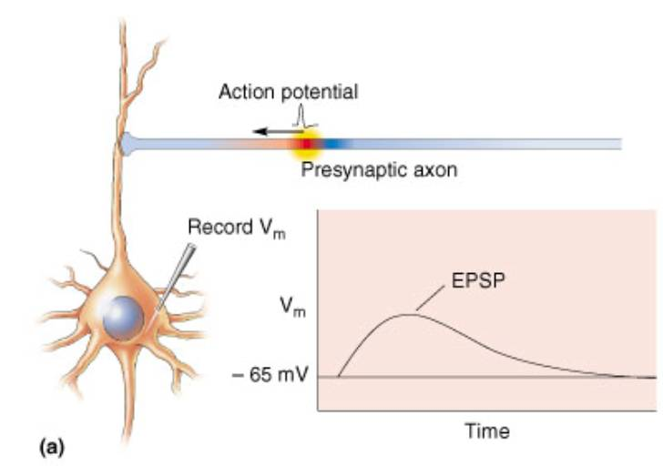
Excitatory post synaptic potential(EPSP)
When the neurotransmitter is glutamate, dopamine, serotonin, acetylcholine etc.
Post synaptic
neuron

Slide 24
Excitatory Post-Synaptic Potential (EPSP)
Release of neurotransmitter from the pre-synaptic terminal
The transmitter binds to receptors on the membrane of the post-synaptic neuron, opening sodium/potassium ion channels
Local depolarization of the membrane of the post-synaptic neuron

Slide 25
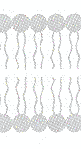
Chemically Gated Ion Channels
Neurotransmitter
Na⁺
Chemically-gated Channel
K⁺
Causes depolarization of Post-synaptic neuron

Slide 26
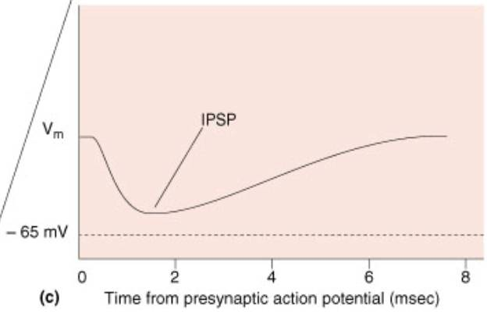
Inhibitory post synaptic potential (IPSP)
When neurotransmitter is GABA or glycine
Post synaptic
neuron

Slide 27
Chemically Gated Ion Channels
Neurotransmitter
Cl⁻
Chemically-gated K⁺ Channel
K⁺
Causes hyperpolarization of Post-synaptic neuron

Slide 28
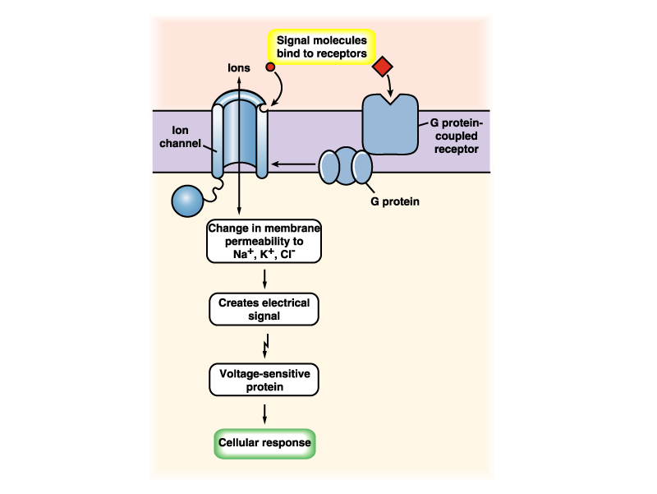
Neurotransmitter receptors
Ionotropic – ligand gated channels
Metabotropic – ligand gated G-protein coupled receptor
All G-protein coupled
receptors have 7 transmembrane
domains
Signal to nucleus
Change in gene expression

Slide 29
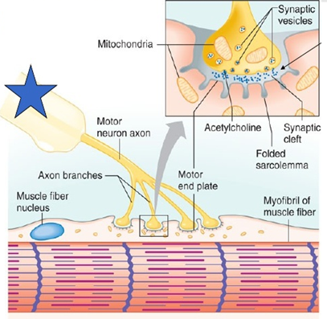
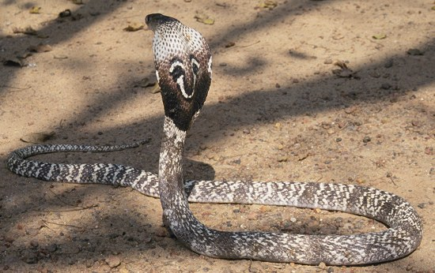
Transmission at nerve muscle junction
Neurotransmitter: Acetylcholine
Nicotinic type of Acetylcholine receptors are present in the skeletal muscles.
This is a cation channel
Kobra snake venum binds with AchR(N)
Blocks neuromuscular transmission
Leading to paralysis of muscles
Acetylcholine released from nerve terminals,
binds to its receptor in the muscle, generates
action potential and muscles contracts.
Notes:
Nicotinic type of AchR is present in skeletal muscles while muscurinic type of AchR is present in smooth muscles.
Nicotinic because nicotine binds to this receptor

Slide 30
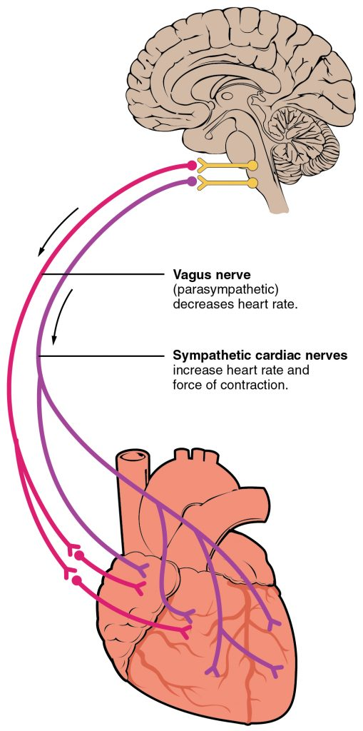
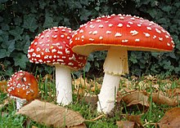
Transmission at nerve muscles junction
Neurotransmitter: Acetylcholine
Heart muscles relaxation
Vagus nerve stimulation releases Acetylcholine that slows heart beat
Heart muscles have muscarinic type of Acetylcholine receptor which is metabotropic in nature
Muscarine present in this deadly mushroom binds to and blocks AchR(M)
Can slow down or stop the heart beat

Slide 31
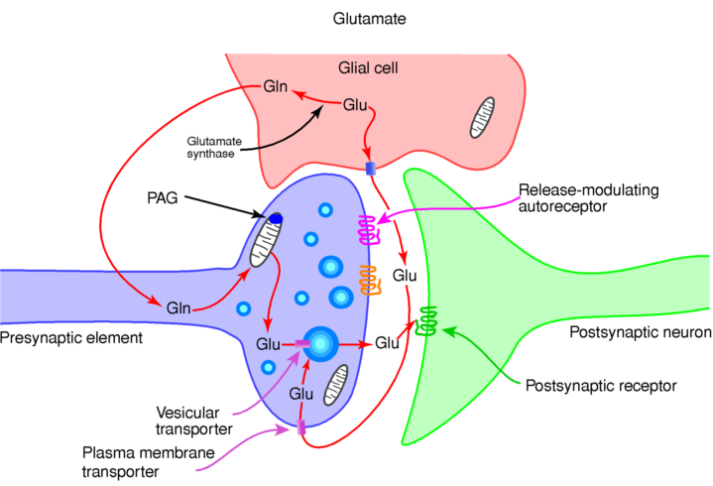
Glutamatergic synapse
Types of glutamate receptors:
Ionotropic
NMDA
AMPA
KINATE
Metabotropic
mGluRs
Neurotransmitters: Glutamate and aspartate
Glutamatergic synapse involved in learning and memory formation
Excessive activity of glutamatergic synapse can lead death of neuron during Epilepsy or Stroke
Notes:
NMDA: N-methyl-D-aspartate
AMPA: α-amino-3-hydroxy-5-methyl-4-isoxazolepropionic acid

Slide 32
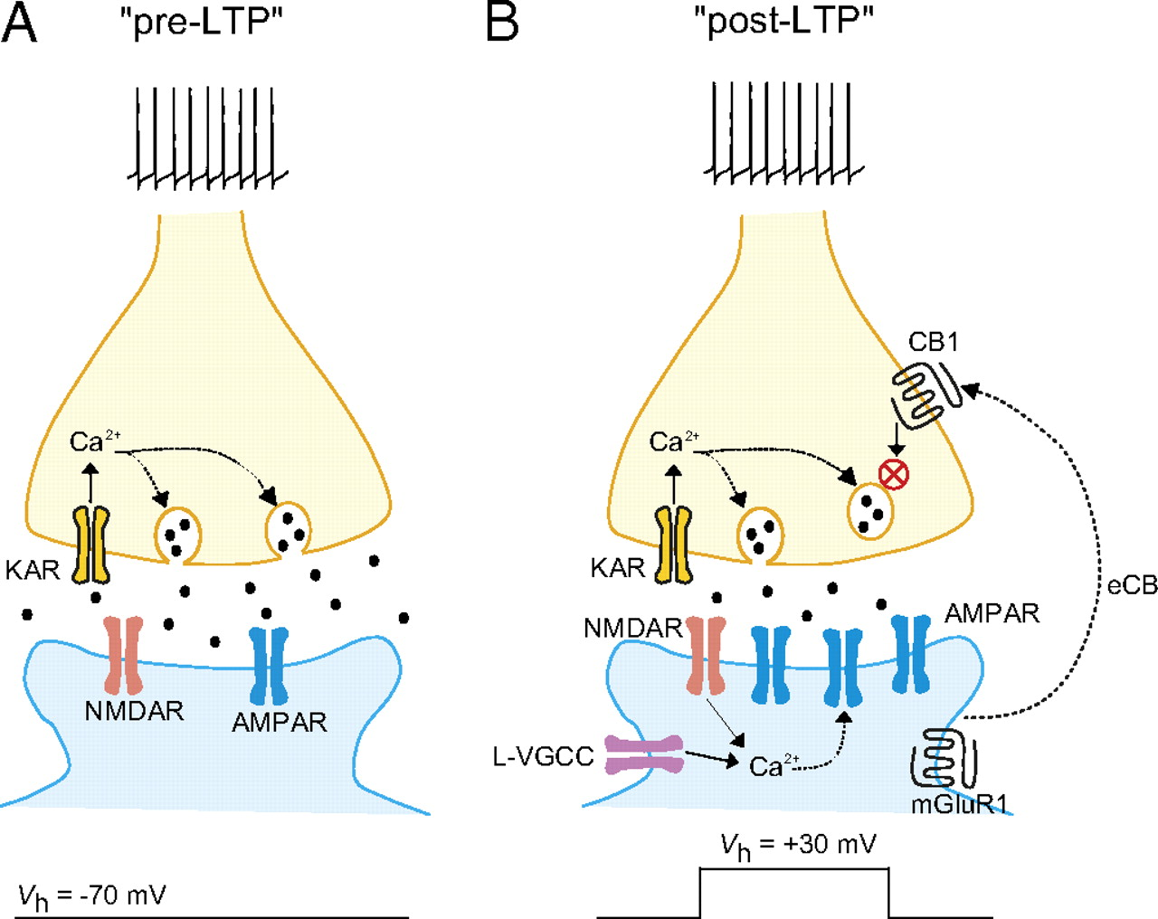
Glutamate receptor, long term potentiation (LTP) and memory
LTP is defined as persistent increase in synaptic strength by repeated stimulation of synapse
LTP causes physical changes in the synapse during memory storage
LTP is the major cellular mechanism that leads to long term memory

Slide 33
Memory storage and recall
Memory is encoded in the form of new synapse and circuits
New proteins are synthesized during memory formation
The circuits involved in forming memory and recalling memory might be same or different
Different memories are stored in different interconnected brain regions

Slide 34
GABAergic synapse
Most of the anaesthetics stimulate the function of GABA receptor
Reduced activity of GABA receptor can cause seizure in epilepsy

Slide 35
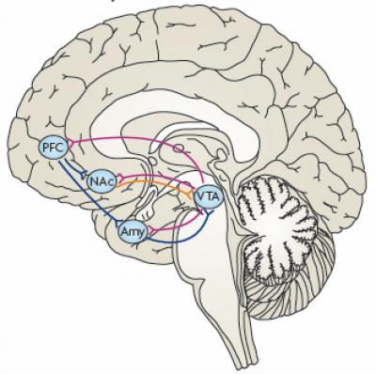
Reward circuitry in the brain
Neurotransmitter: Dopamine
Reward pathway is responsible for:
reward related memory,
pleasure motivation,
desire etc.
Most abused drugs activates this pathway, for example:
Cocaine
Amphetamine
Heroine
LSD
Cannabis
VTA: Vental tegmental area
Amy: Amygdala
Nac: Nucleus acumbence
PFC: Prefrontal cortex

Slide 36
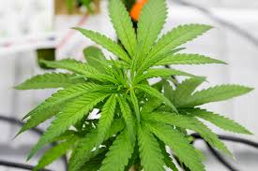
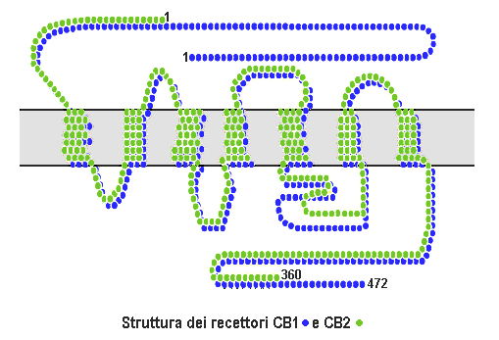
Cannabis, Euphoria and pain relief
Euphoria: intense pleasure or happiness
Cannabinoid works through cannabinoid receptor (G-protein coupled receptor)
Cannabinoid receptors widely expressed in all parts of the brain
Endogenous ligand: Anandamides
It is produced and released by neurons during laughing, exercise, injury etc.
Paracetamol activates cannabinoind receptor and induces relief from pain

